Slide 1
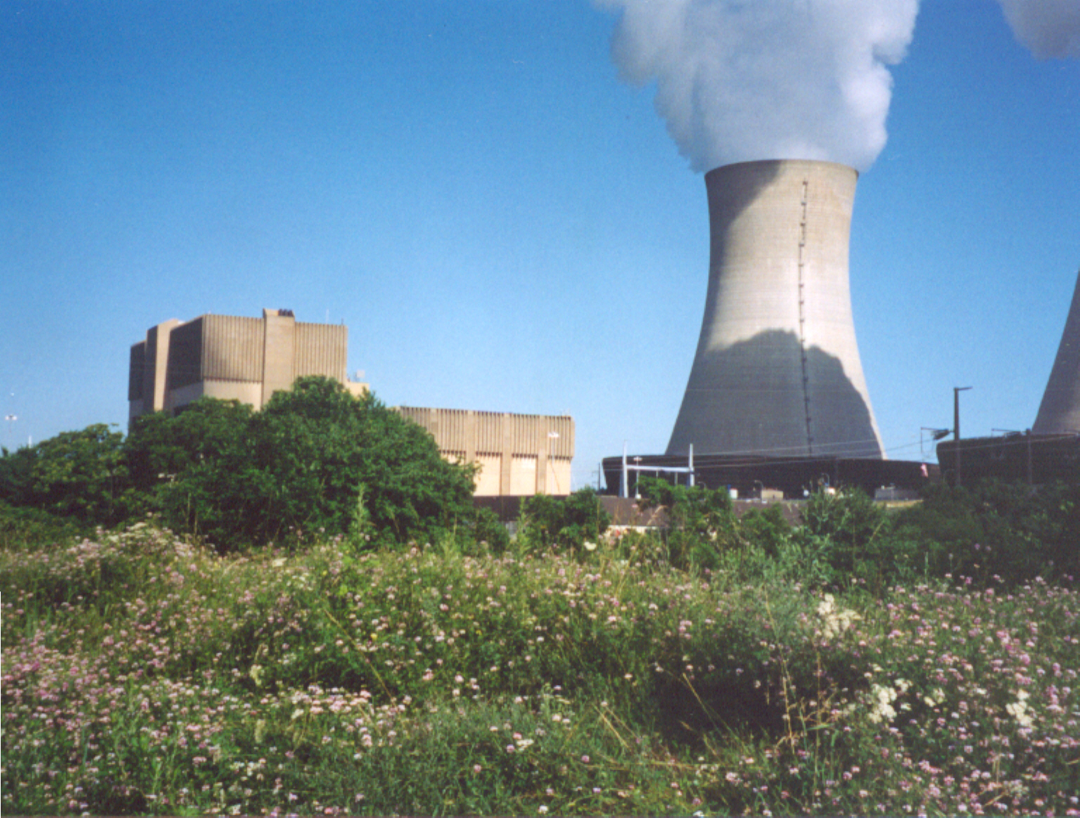
6.3
Solids of Revolution
Limerick Nuclear Generating Station, Pottstown, Pennsylvania
Photo by Vickie Kelly, 2003
Greg Kelly, Hanford High School, Richland, Washington
Notes:
LIMERICK GENERATING STATION
Limerick Generating Station, located in Limerick Township, Montgomery County, PA, is a two-unit nuclear generation facility capable of producing enough electricity for over 1 million homes. The plant site is punctuated by two natural-draft hyperbolic cooling towers, each 507 feet tall, which help cool the plant.
Limerick's two boiling water reactors, designed by General Electric, are each capable of producing 1,143 net megawatts. Unit 1 began commercial operation in February 1986, with Unit 2 going on-line in January 1990.

Slide 2


Suppose I start with this curve.
My boss at the ACME Rocket Company has assigned me to build a nose cone in this shape.
So I put a piece of wood in a lathe and turn it to a shape to match the curve.

Slide 3

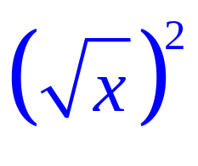

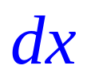
How could we find the volume of the cone?
One way would be to cut it into a series of thin slices (flat cylinders) and add their volumes.
The volume of each flat cylinder (disk) is:
In this case:
r= the y value of the function
thickness = a small change in x = dx

Slide 4
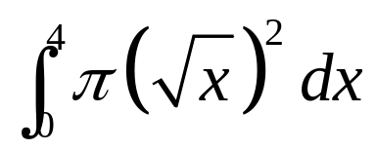
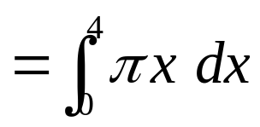
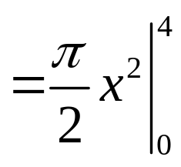

The volume of each flat cylinder (disk) is:
If we add the volumes, we get:

Slide 5
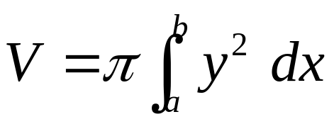
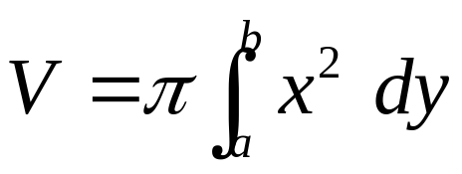
This application of the method of slicing is called the disk method. The shape of the slice is a disk, so we use the formula for the area of a circle to find the volume of the disk.
If the shape is rotated about the x-axis, then the formula is:
Since we will be using the disk method to rotate shapes about other lines besides the x-axis. Here is another equation that will help:
A shape rotated about the y-axis would be:

Slide 6
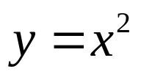




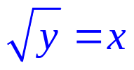
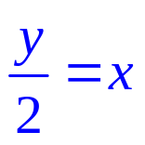
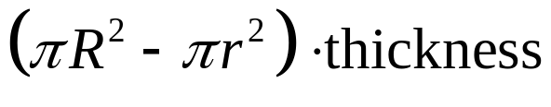
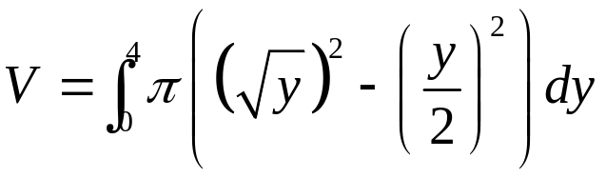
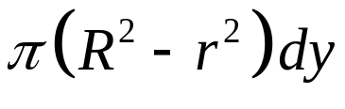
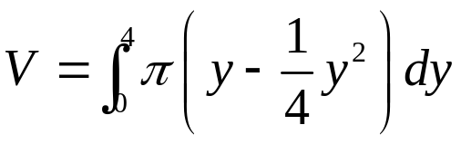
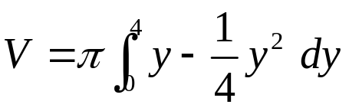
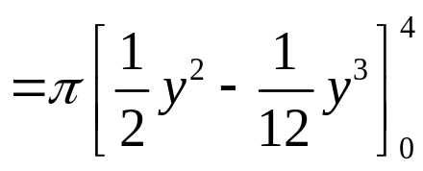
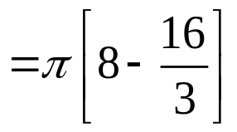
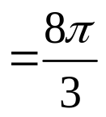
The region bounded by
and is revolved about the y-axis.
Find the volume.
If we use a horizontal slice:
The “disk” now has a hole in it, making it a “washer”.
The volume of the washer is:
outer
radius
inner
radius

Slide 7
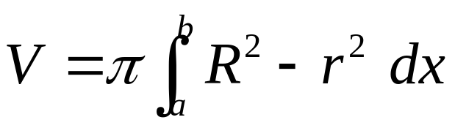
This application of the method of slicing is called the washer method. The shape of the slice is a circle with a hole in it, so we subtract the area of the inner circle from the area of the outer circle.
The washer method formula is:

Slide 8
AP 2007 #1 part b (x-axis)
Get out packet
Read problem
Discuss method and shape
Visual of shape
Solve
Notes:
Blue bicycle wheel

Slide 9
AP 2006 #1 part c (y-axis)
Read problem
Discuss method and shape
Visual of shape
Solve
Notes:
White cone

Slide 10
AP 2003 #1 part b (y = a)
What is different? What line are we rotating around? How will this change our integral?
Visualize and explore shape
Line above, then r = line minus function
Line below, then r = function minus line
Notes:
Yellow/blue bundt cake

Slide 11
AP 2006 #1 part b (y = a)
What is different? What line are we rotating around? How will this change our integral?
Visualize and explore shape
Line above, then r = line minus function
Line below, then r = function minus line
Notes:
Blue bowl

Slide 12
Now you try AP Q’s!
Finish AP 2004 #2
Area
Volume of revolution
Volume with perpendicular cross sections
Notes:
Blue doughnut

Slide 13
6.3 Solids of Revolution pt. 2
Shell method

Slide 14
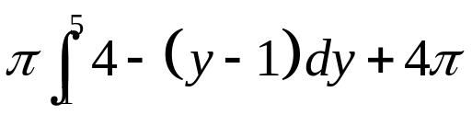
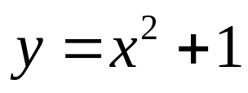

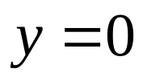
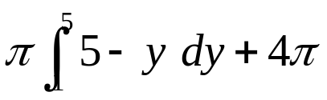

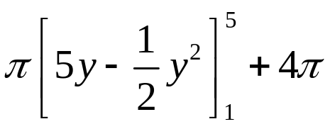
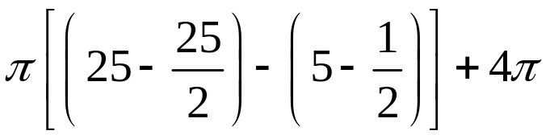


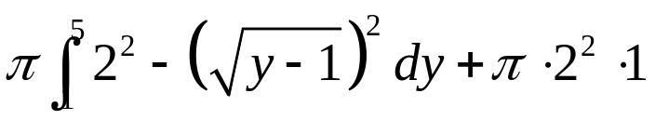
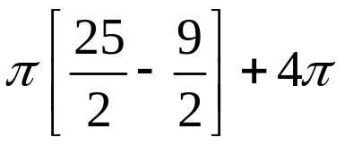
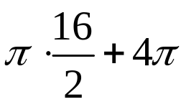


Find the volume of the region bounded by , , and revolved about the y-axis.
We can use the washer method if we split it into two parts:
inner
radius
cylinder
outer
radius
thickness
of slice

Slide 15
Shell Method
We could solve the previous problem another way that would be easier.
Let’s explore this method first and come back to the problem

Slide 16
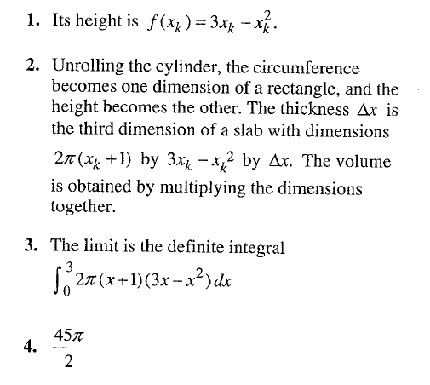
Proof of Shell Method
Notes:
Pass out q’s and pictures

Slide 17
Here is another way we could approach this problem:
cross section
If we take a vertical slice
and revolve it about the y-axis
we get a cylinder.
If we add all of the cylinders together, we can reconstruct the original object.

Slide 18

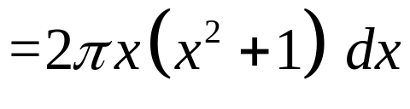




cross section
The volume of a thin, hollow cylinder is given by:
r is the x value of the function.
h is the y value of the function.
thickness is dx.

Slide 19
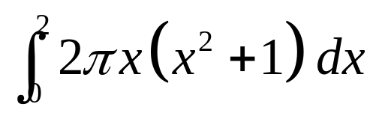
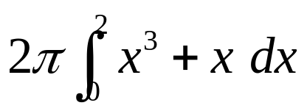
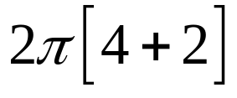
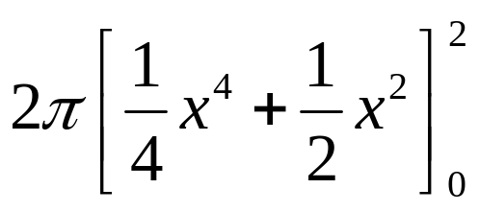

This is called the shell method because we use cylindrical shells.
cross section
If we add all the cylinders from the smallest to the largest:

Slide 20
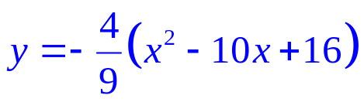
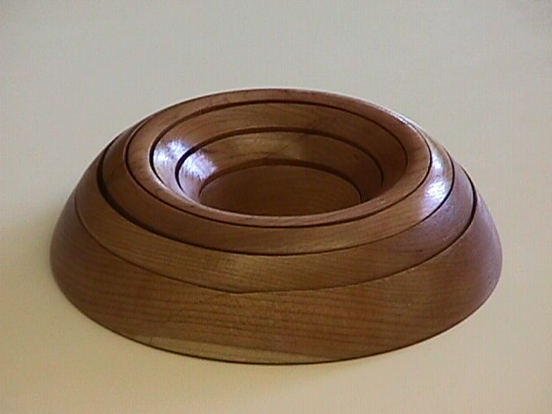
Find the volume generated when this shape is revolved about the y axis.
We can’t solve for x, so we can’t use a horizontal slice directly.

Slide 21

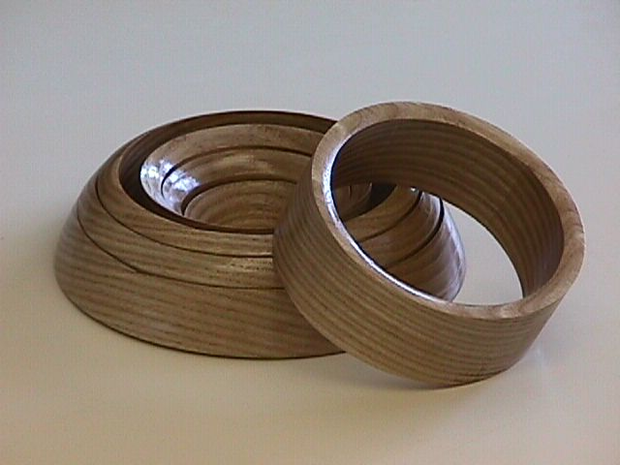


If we take a vertical slice
and revolve it about the y-axis
we get a cylinder.
Shell method:
Notes:
This model of the shell method and other calculus models are available from: Foster Manufacturing Company, 1504 Armstrong Drive, Plano, Texas 75074-6027 Phone/FAX: (972) 424-3644 http://home.flash.net/~fmco

Slide 22
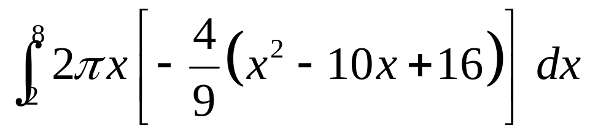

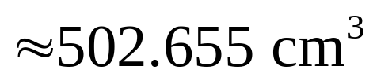
Note:
When entering this into the calculator, be sure to enter the multiplication symbol before the parenthesis.

Slide 23
When the strip is parallel to the axis of rotation, use the shell method.
When the strip is perpendicular to the axis of rotation, use the washer method.
π

Slide 24
AP 2006 #1 part c (shell method)
We solved part c with washers and now lets do it with shell
Visualize explore shape
Why is shell better or different?
Notes:
Blue bowl

Slide 25
6.3 Solids of Rev.
Pg. 381 – 382: #5, #23, #29, #35

Slide 26
6.4 Shell
Pg. 389: #4, #15, #27
Just set up Integrals

